Slide 1


Project Name
Brain Tumor Detection and Classification Using
Artificial Intelligence
TEAM MEMBER’S: L.Jyothsna
S.Surabhi ROLL NO: 227Y1A6682
227 Y1A66B8 BATCH NO:32

Slide 2
Brain Tumor Detection and Classification
using Artificial Intelligence

Slide 3

Abstract
Brain tumors are a critical health concern worldwide, often requiring accurateand timely diagnosis for effective treatment planning.
Traditional methods oftumor detection involve manual inspection of medical images by radiologists,which can be time-consuming and subjective.
This paper proposes a novel approach for brain tumor detection and classification
using AI.
Keywords: Brain Tumor (BT), MRI-Images, CT, IP, X-ray.

Slide 4
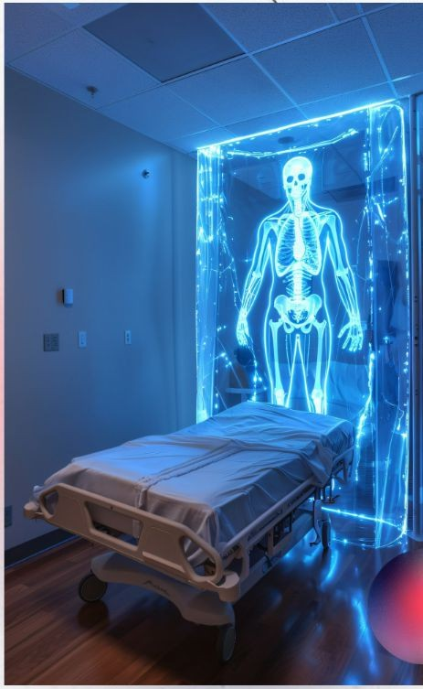
Introduction
Brain tumors represent a significant challenge in modern medicine, with varying types and complexities that necessitate accurate and timely diagnosis for effective treatment planning. The traditional methods of diagnosing brain tumors primarily on radiological imaging techniques such as
->Magnetic Resonance Imaging (MRI).
->Computed Tomography (CT).

Slide 5

Challenges in Detection
1.Dataset Quality and Size:AI models for brain tumor detection annotated require large and diverse datasets of medical images.
2.Tumor Heterogeneity: Brain tumors exhibit considerable heterogeneity in terms of their histological types, genetic mutations, and growth patterns.

Slide 6

Enhancing Accuracy
Enhancing accuracy for brain tumor detection and classification using AI involves several key strategies and considerations to improve the performance and reliability of AI systems.
High-Quality Data Collection and Preparation:
Large and Diverse Datasets: Gathering a comprehensive dataset of brain MRI or CT scans that include various types of tumors, different imaging protocols, and diverse patient demographics is crucial.

Slide 7

AI in Medical Imaging
1.Automated Detection and Segmentation:
Convolutional Neural Networks (CNNs):
AI algorithms, particularly CNNs, areadept at automatically analyzing and interpreting medical images.
2.Classification of Tumor Type:
. Machine Learning Models: AI-based classifiers trained on labeled datasets can differentiate between different types of brain tumors, such as gliomas, meningiomas, and metastases.

Slide 8
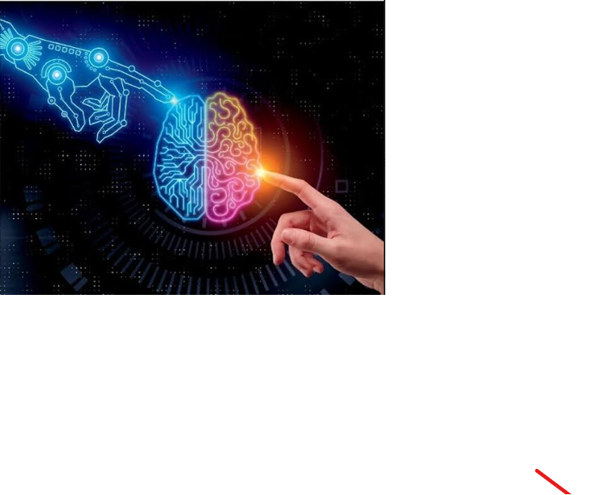
Algorithms
Algorithms for Brain Tumor Detection from MRI Images
1. Data Preprocessing
2. Image Segmentation
3. Feature Extraction
4. Classification
5. Post-Processing

Slide 9
1. Data Preprocessing
Algorithm: MRI Image Preprocessing
Input: Raw MRI images.
Steps:
Load MRI image.
Normalize image intensity:
Convert pixel values to a common scale.
Use normalization techniques like min-max normalization.
Apply noise reduction:
Output: Preprocessed MRI images.

Slide 10
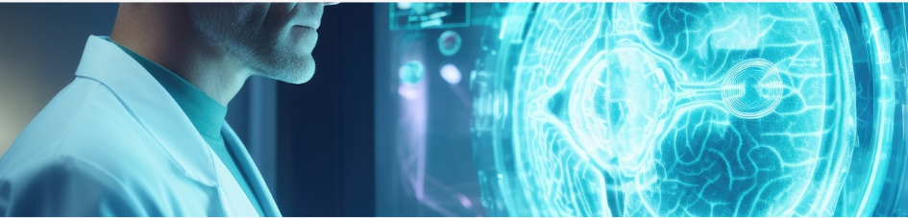
2. Image Segmentation
Algorithm: Tumor Segmentation
Input: Preprocessed MRI image.
Steps:
Apply thresholding:
Use global or adaptive thresholding to separate the tumor from the background.
Convert the image to a binary format where potential tumor regions are marked.
Use edge detection:
Apply Sobel or Canny edge detection to identify the boundaries of the tumor.
AI.
Output: Binary mask of the tumor region.

Slide 11
3.Feature Extraction
Algorithm: Feature Extraction
Input: Segmented tumor region.
Steps:
Extract shape features:
Calculate area (number of pixels in the tumor region).
Compute perimeter (length of the boundary of the tumor).
Determine compactness (ratio of the area to the square of the perimeter).
Output: Feature vector describing the tumor.

Slide 12

4. Classification
Algorithm: Tumor Classification
Input: Feature vector.
Steps:
Load pre-trained classifier (e.g., Support Vector Machine, Random Forest, k-Nearest Neighbors).
Input the feature vector into the classifier.
Obtain classification result from the classifier
Output: Feature vector describing the tumor.

Slide 13
5. Post-Processing
Algorithm: Post-Processing
Input: Classification result.
Steps:
Overlay segmented tumor on the original MRI image:
Superimpose the binary mask of the tumor region onto the original MRI image for visualization.
Display the classification result:
Output: Visualization and report generation.

Slide 14
Conclusion
In conclusion, the application of artificial intelligence (AI) in the detection and classification of brain tumors represents a significant advancement in medical diagnostics.

Slide 15
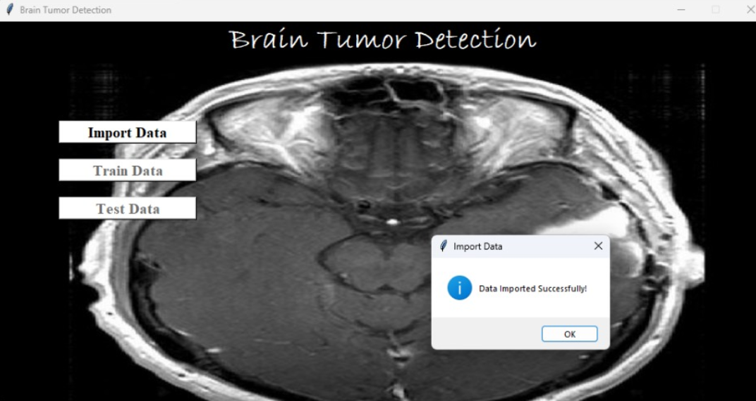
output’s

Slide 16
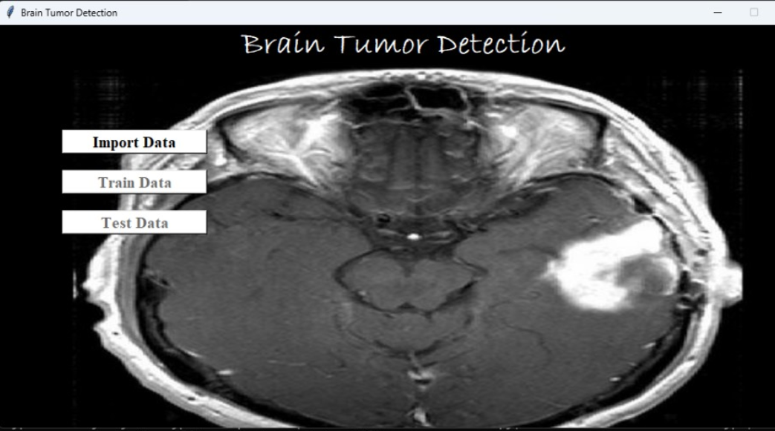
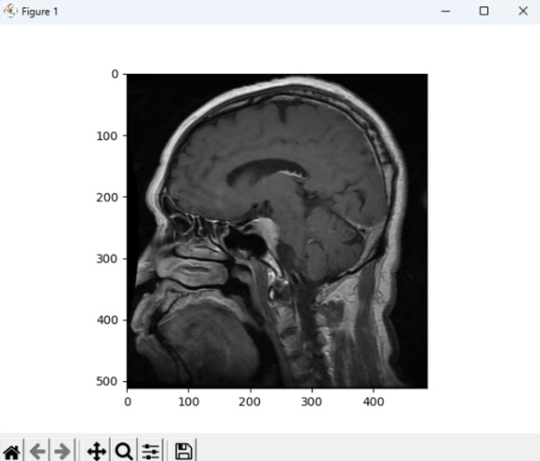
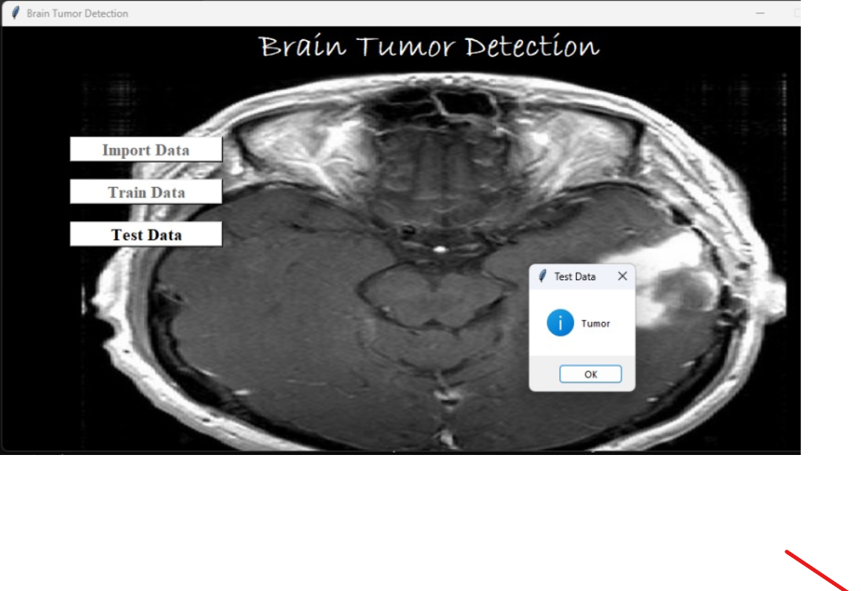
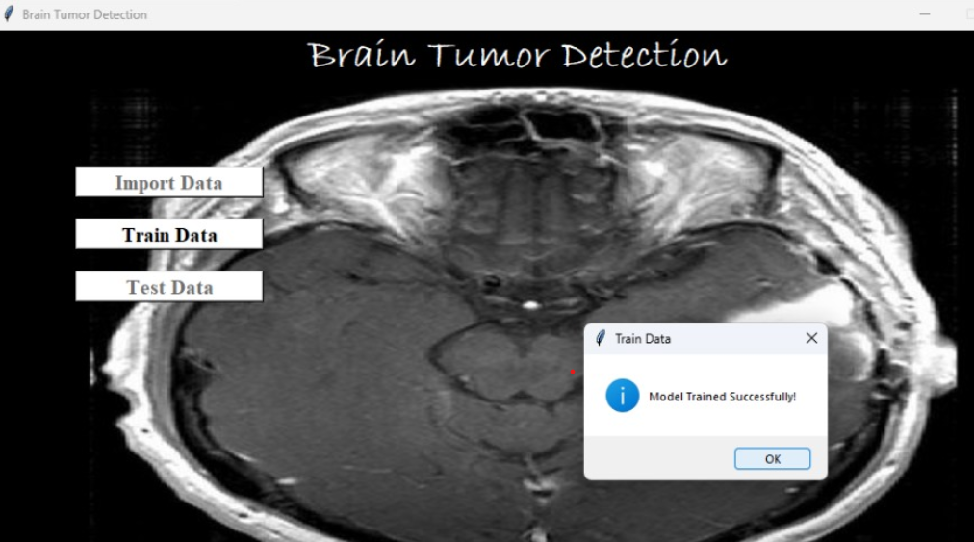
.

Slide 17

.

